Slide 1
RABIN CRYPTOSYSTEM

Slide 2
RABIN CRYPTOSYSTEM
Rabin Cryptosystem is an public-key cryptosystem invented by Michael Rabin. It uses asymmetric key encryption for communicating between two parties and encrypting the message.
Rabin cryptosystem is based on quadratic congruence .
The Rabin cryptosystem can be thought of as an RSA cryptosystem in which the value of e and d are fixed. The encryption is C ≡ P² (mod n) and the decryption is P ≡ C^{1/2} (mod n).
The encryption : C = p² mod n
The decryption : P= C^{1/2} (mod n).
In Rabin cryptosystem public key is “n” and private key is “ p and q”

Slide 3
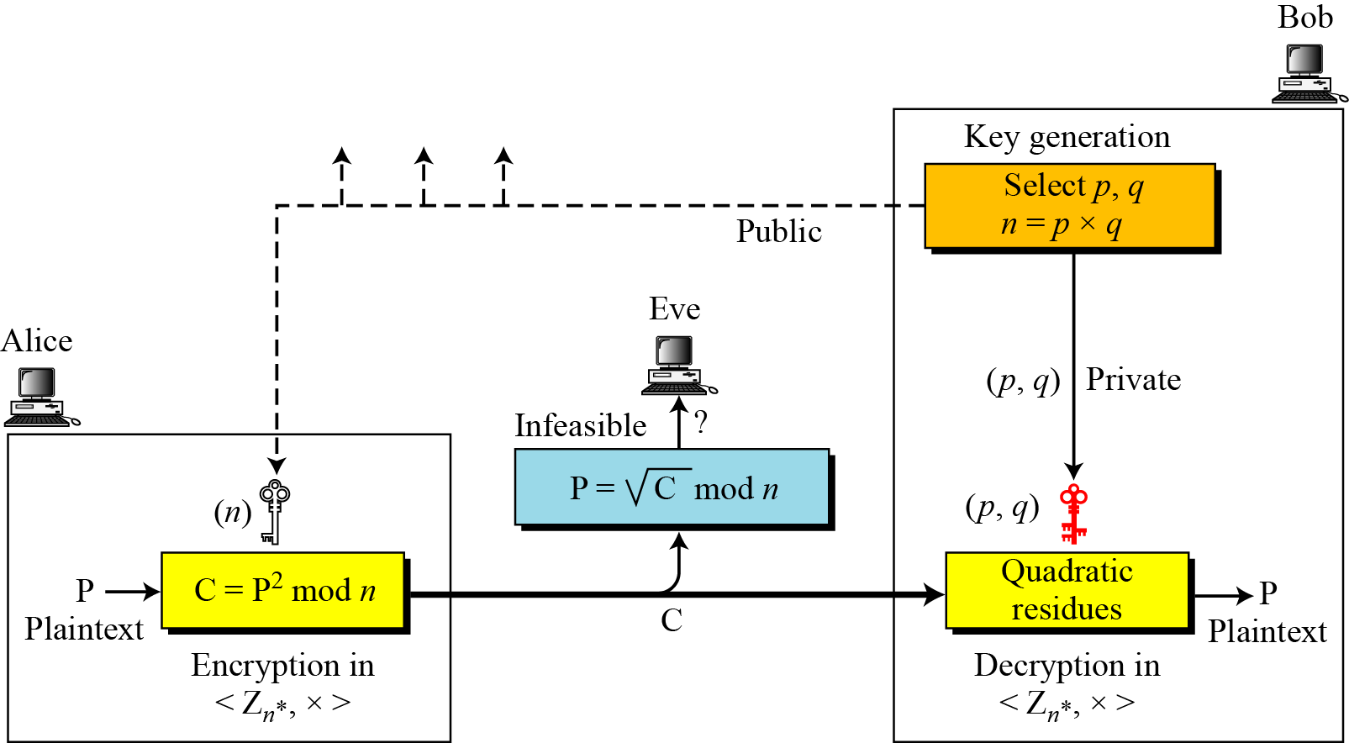
Rabin cryptosystem

Slide 4
Steps in Rabin cryptosystem
Key generation
Generate two very large prime numbers, p and q, which satisfies the condition p ≠ q → p ≡ q ≡ 3 (mod 4) or 4K + 3 & p ≠ q For example: p=139 and q=191
Calculate the value of n n = p.q
Publish n as public key and save p and q as private key

Slide 5
Encryption
Get the public key n.
Convert the message to ASCII value. Then convert it to binary and extend the binary value with itself, and change the binary value back to decimal m.
Encrypt with the formula: C = p² mod n
Send C to recipient.

Slide 6
Decryption
NOTE: The Rabin cryptosystem is not deterministic: Decryption creates four plaintexts

Slide 7
EXAMPLE:
Bob selects p = 23 and q = 7. Note that both are congruent to 3 mod 4.
Bob calculates n = p × q = 161.
Bob announces n publicly; he keeps p and q private.
Alice wants to send the plaintext P = 24. Note that 161 and 24 are relatively prime; 24 is in Z₁₆₁*.
She calculates C = 24² = 93 mod 161, and sends the ciphertext 93 to Bob.

Slide 8
Bob receives 93 and calculates four values: a₁ = +(93 ^{(23+1)/4}) mod 23 = 1 mod 23 a₂ = −(93 ^{(23+1)/4}) mod 23 = 22 mod 23 b₁ = +(93 ^{(7+1)/4}) mod 7 = 4 mod 7 b₂ = −(93 ^{(7+1)/4}) mod 7 = 3 mod 7
Bob takes four possible answers, (a₁, b₁), (a₁, b₂), (a₂, b₁), and (a₂, b₂), and uses the Chinese remainder theorem to find four possible plaintexts: 116, 24, 137, and 45. Note that only the second answer is Alice’s plaintext.

